Slide 1
A Level Product Design Transition project
Open your eyes to the world around you Design and engineer your own future and create a better world for all of us.

Slide 2
The course Structure
Non-exam assessment (NEA) 50%
Practical application of technical principles, designing and making principles
The major project is worth 50% of your total mark you set your project and select your client so you can lean your project towards your areas of interest or your planned further studies.
Paper 1
Technical principles Written exam: 2 hours and 30 minutes
120 marks 30% Is a Mixture of short answer and extended response.
Paper 2
Designing and making principles Written exam: 1 hour and 30 minutes
80 marks 20% is a mixture of short answer and extended response questions.
Section A: Product Analysis: 30 marks Up to 6 short answer questions based on visual stimulus of product(s).
Section B: Commercial manufacture: 50 marks Mixture of short and extended response questions

Slide 3
The purpose of this project
To help you understand the course, its structure and requirements (slide 2)
Get to know each other (about me slide 4 about you your response to the tasks)
To highlight how useful the range of professional skills we cover can be for your future in Design, Engineering or to your own business (about Me Slide 4)

Slide 4
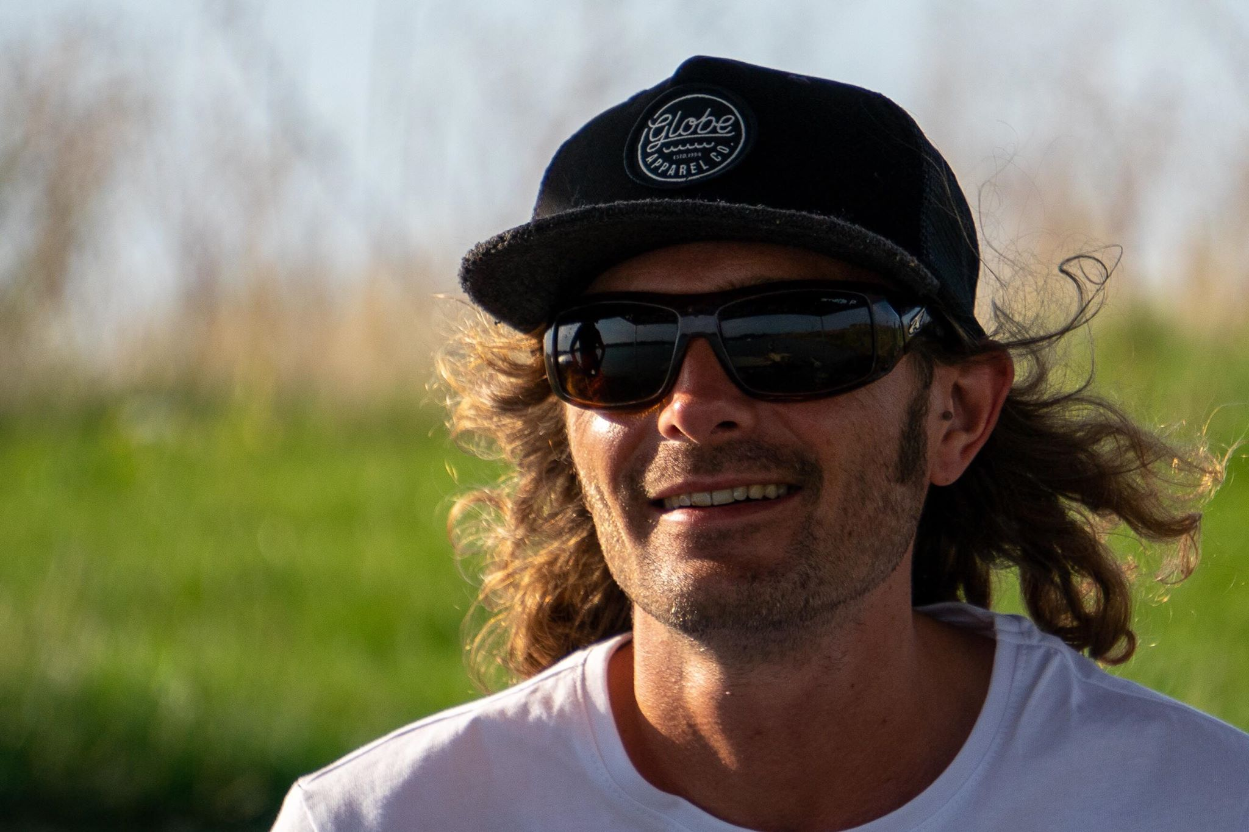
About Me
Subject leader of DT at the TDA (I will be in the academy 3 days a week you can come and ask me questions and get help whenever I am in the building)
Teacher of DT, Engineering construction and related disciplines for 12 years
Consultant designer/design engineer 18 years (I work mostly in the disciplines I love and am interested in which are board sports design, extreme sports facility design, vehicles and sustainable design / construction occasionally I will do a project that does not interest me but I quote silly prices for those so it pays off)
Extreme sports athlete and coach Snowboarding, Wakeboarding, Climbing 20 years.
Business man/entrepreneur, Peterborough WakePark, Brainchild designs, Blank Wake

Slide 5
How I use design skills to change my life and how they can change yours (with practice and a little hard work)
Have a look at my website www.peterboroughwakepark.com every part of this project has been designed and hand made by me with a little help from my friends.
Research, Evaluation, Analysis and perseverance: I wrote a specification for what I needed from a site for this project before I started anything else. I continue to use these skills at every phase of the project to convince councils, land owners, loan companies and other party's to back the project and get consents. I constantly re-evaluate decisions and designs to reduce costs and increase quality.
Sketching, Everything starts as a sketch it helps me process ideas and is invaluable in discussions
CAD CAM, Every detail of the park, its buildings, ramps, equipment all get CAD modeled these are used for visual analysis of scale, proportions, aesthetics and presenting to 3rd party's. Planning consent, costing estimates, checking its possible to build, materials requirements, making sure things float where needed, sending files to CNC machines for automated manufacturing and countless other tasks.
Graphics software Photoshop and illustrator are used to generate composite images to place CAD and real objects for aesthetics and presentation purposes. They are also used to generate logos, vouchers, professional documentation, uniform and clothing designs
Risk assessing is very important in design and making but also in running a business A bit of extra paperwork at the start can help avoid injury's to yourself and others and save you allot of issues down the line.
Manual making skills and material and processing knowledge, the more skills you have and the more you know the more opportunities are available to you my aim was to create the best facility at the lowest cost that meant I had to build everything myself and the range of skills and materials used is endless. I lean on a few specialist friends every now and then but the more you know the easier it is to communicate effectively even if you are not doing it yourself.
Sustainability is a core value of the business and being able to spot opportunities to use other peoples waste saves me allot of money. My clubhouse and workshop are both end of life shipping containers and we save thousands of pounds a year by simply spotting opportunities to take someone elses waste and turn it into something we want or need.

Slide 6
Project 1 Live Brief Dealing with covid-19 in a watersports center
In order to reopen during covid all the Research, Evaluation, Analysis and perseverance skills came into play as I had to read endless government documentation before bringing in the risk assessment writing and following up with making physical adjustments to the site and generating posters watch the clip bellow to see some of what we did to ensure we are Covid secure.
https://youtu.be/42kLd50sIKQ
Your Brief is a live project that I am already working on so it will be really interesting to see if you are having similar ideas or have something totally out of the box
Situation: Watersports facilities have been allowed to partially reopen across the country but currently we cannot issue rental equipment due to covid-19. My venue Peterborough WakePark and the rest of the industry need a way to clean wetsuits, buoyancy aids, helmets and boards that kills covid-19 without damaging the equipment before we can offer beginners lessons again safely.
Brief: Design a system that can kill the covid-19 virus on any or all of the items listed in the situation. It should be simple and easy to use so that customers can do it after their lesson with very simple instructions and in a short time period. It should not damage the equipment which is mostly neoprene rubber and other plastics and rubbers. It would be preferable not to use chemicals but if they are needed they must be cheap, readily available proven to work against covid-19 and not damaging to the environment or the next customers skin.

Slide 7
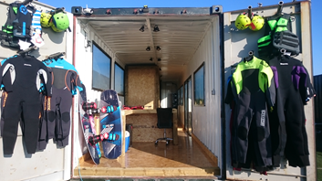
Rental equipment

Slide 8
So what do I want you to do/produce for project 1
I want you to submit a final design for a product or system that responds to the Situation and Brief on slide 6
You can present your concept in any medium from high quality sketches, physical models, or CAD models but it all needs to end up on one A3 page fully annotated and explained.
In order to do this you will need to research ways of killing the virus on objects and surfaces but also what materials the equipment are made of so you can go with an option that does not damage the kit. It should also look professional and be easy to use as it needs to be used by the customer and give them peace of mind that their safety is being put first.
You can submit a photograph of your final page or put it together and annotate digitally in PowerPoint or any other software you have access too.

Slide 9
Project 2 is all about you
Through project one you will have an insight into what I do and love Project 2 should be about you and what you love (or love to hate) indifference is our enemy I want to see your passion it will help me get to know you.
Pic an area of interest for yourself and write a Situation and Brief like mine it needs to outline a problem or opportunity to design for (we don’t have to make it so if you want to colonize mars that’s fine but Elon has a head start on you). Alternatively choose something you hate doing and design a way out of it (my robot mower has mowed over 1000 hours for me I didn’t design it but am grateful to whoever did)
Sketch out or model 3 concept designs to solve your own chosen problem annotate them clearly and send them in as a photo of manual work or put together on a computer again the choice of medium is yours.

