Slide 1
Economics
A-level transition work project two

Slide 2
Year 12 Economics covers two areas
Macroeconomics
Focuses on the “big picture” whole economy concepts you will, most likely, have heard of on the news or elsewhere.
Examples: unemployment, interest rates, GDP and growth, aggregate demand, and inflation.
Subject of “project two”

Slide 3
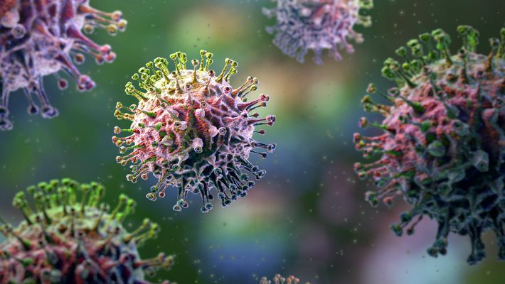
Task: To investigate the impact of the coronavirus on the UK
Areas considered:
Economic growth
Unemployment
Employment
Inflation
Interest rates
Government borrowing
Imports and Exports

Slide 4
How has coronavirus affected economic growth?
Economic growth- when there is an increase in real GDP
GDP measures the total amount of output of goods and services in a year
Coronavirus affects the start of 2020- how has it affected economic growth at the start of 2020? (Give an economic growth rate for 2019 and for 2020 in your answer)
The data for the start of 2020 is the first 3 months of the year- what do you expect to happen in the next 3 months to output? Why?
https://tradingeconomics.com/united-kingdom/gdp-growth

Slide 5
How has coronavirus affected unemployment?
Unemployment:- where people are willing and able to work but unable to find suitable employment
Claimant count:- the number of people claiming unemployment related benefits
Right at the end of the chart is 2020. What happens to the number having to claim unemployment benefits?
(give a number from 2019 and a number for 2020 in your answer)
How will the change in the numbers claiming unemployment benefit affect the UK Government? Why?
https://www.theguardian.com/business/2020/may/19/uk-jobless-april-coronavirus-crisis-unemployment-benefits#maincontent

Slide 6
How has coronavirus affected employment?
Furlough:- where an employer and employee agree not to work for a period of time
Whilst furloughed the government pays a percentage of your usual earnings. In April this was 80%.
The Chart shows the number of people in millions furloughed each week in April and May. What happens to the number of people furloughed?
(give a number from the start of the period and the end in your answer)
How will the change in the numbers furloughed affect the UK Government? Why? How might this benefit businesses if the Government is paying them? https://www.statista.com/statistics/1116638/uk-number-of-people-on-furlough/

Slide 7
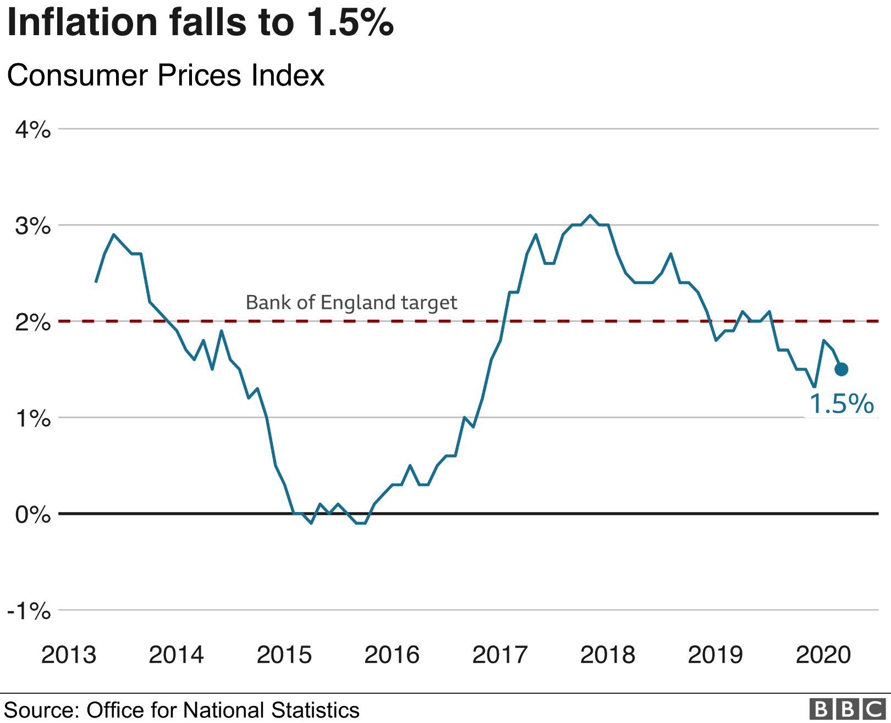
How has coronavirus affected inflation?
Inflation:- where average prices are rising
Deflation:- where average prices are falling
Disinflation:- where average prices are rising but at a slow rate
The Chart shows the inflation rate. What happens to the inflation rate in 2020?
(give the percentage increase in prices from 2018 or 2019 and give the final value in your answer)
The Bank of England has a target- this is the percentage inflation they try to achieve- What is the inflation target percentage? Has coronavirus moved us closer to or further from the target? https://www.bbc.co.uk/news/business-52371062

Slide 8
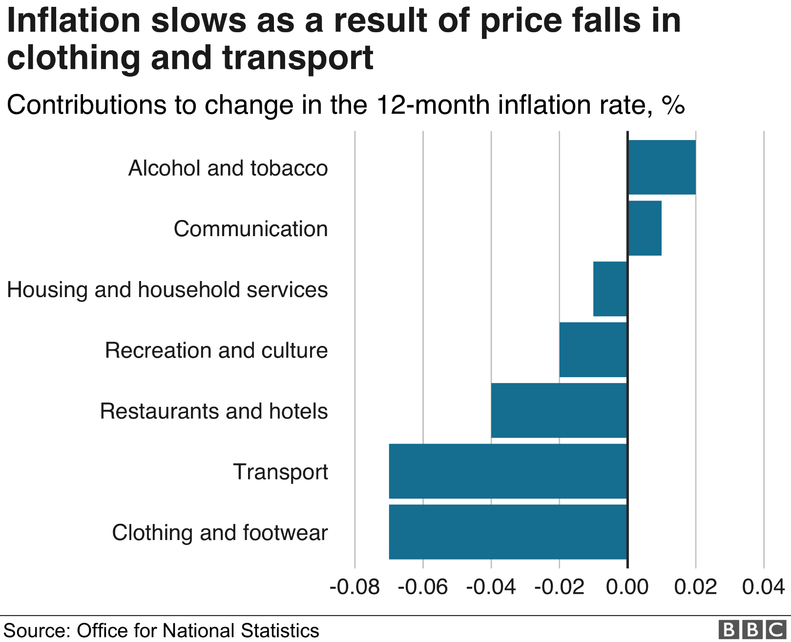
How has coronavirus affected inflation?
This chart shows the percentage change in the prices of different products
What types of products saw prices rise during the last 12 months?
(use numbers in your answer)
What types of products saw prices fall during the past 12 months?
(use numbers in your answer)
What did we call it on the last slide when average prices fall? Why do you think the price of clothes and transport have fallen? https://www.bbc.co.uk/news/business-52371062

Slide 9
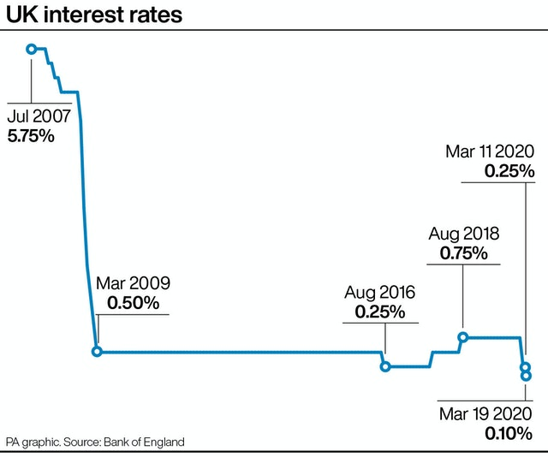
How has coronavirus affected interest rates?
Interest rates:- the cost of borrowing
When you take a loan this is the amount they charge you extra.
When you have savings this is the amount the bank rewards you
Interest rates are used to help control inflation
What happened to interest rates in March 2020?
(use percentage point changes in your answer)
Will lower interest rates lead to more or less people borrowing money? Will savers be happy with lower interest rates?
https://www.eveningexpress.co.uk/news/business/bank-slashes-rates-to-record-low-of-0-1-to-shore-up-coronavirus-hit-economy/

Slide 10
How has coronavirus affected government borrowing?
The government earns tax revenue
The government spends money
Budget deficit:- When the government spends more than it earns in taxation
The budget deficit for 2020-21 is estimated at £284 billion
The government will need to borrow this money.
What will happen to the interest the government has to pay back if it borrows more?
£284 billion
What might have to happen to taxes in the future to be able to pay off this debt?
http://obr.uk/coronavirus-analysis/

Slide 11
How has coronavirus affected exports and imports?
Exporting less: 72%
Importing less: 59%
Exports are where we sell British goods abroad
Imports are where we buy goods from abroad
How have exports and imports been affected by Coronavirus? (Use numbers in your answer)
What has made importing and exporting harder?
https://www.ons.gov.uk/businessindustryandtrade/internationaltrade/articles/theimpactofcoronaviruscovid19onexportingandimportingbyukbusinesses/20aprilto3may2020

Slide 12
Challenge: Choose another country and look at the impact of Covid-19 on that country
www.tradingeconomics.com
Consider the impact on any 3 of the following
Economic growth
Unemployment
Inflation
Interest rates
Does it look like they have been affected more or less than the UK?

Slide 13
Economics
A-level transition work project two

