Slide 1
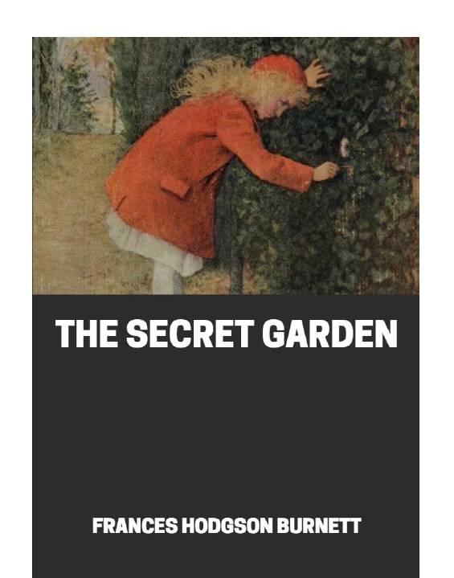
The Secret Garden
Yesterday, we started chapter 4 and you should have learnt who Martha is and how she is different to Mary’s Ayah.
Today we will carry on reading chapter 4.

Slide 2
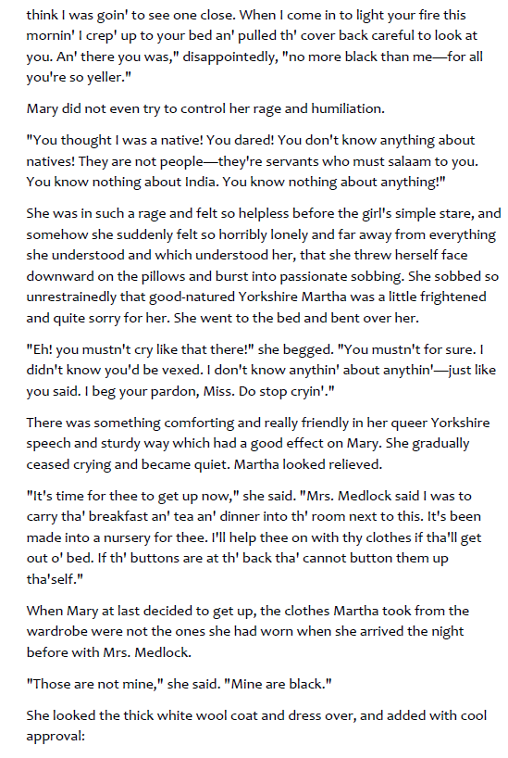
Questions: all on this slide and in chronological order
Explain why Mary is so angry?
Why do you think Mary starts sobbing?
How did Martha feel?

Slide 3
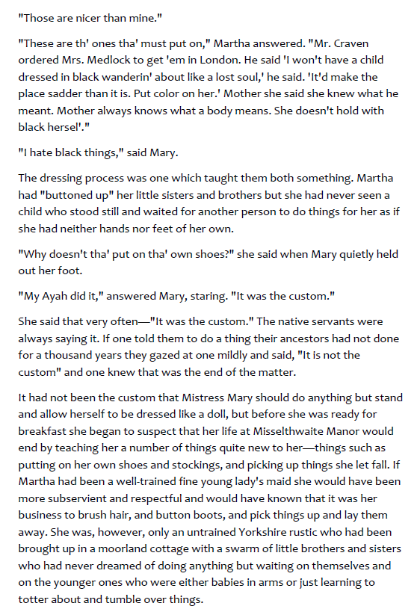
Questions: all on this slide and in chronological order
4) What impression do you get of Mr. Craven when he orders a new dress for Mary?
5) What does the word custom mean and why does Mary keep using it?

Slide 4
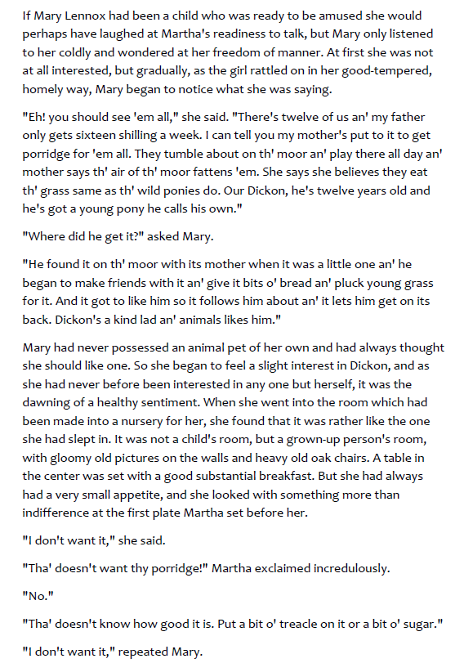
Questions: all on this slide and in chronological order
6) Why was Mary not interested in what Martha had to say at first?
7) Who is Dickon?
8) ‘it was the dawning of a healthy sentiment’ What is the author trying to tell you?

Slide 5
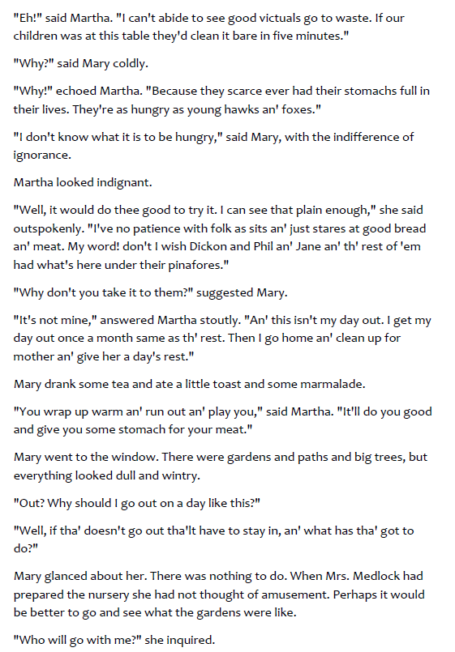
Questions: all on this slide and in chronological order
9) Why do you think Mary doesn’t know what hunger feels like?
10) What do you think Mary expected to be in the nursery?

