Slide 1
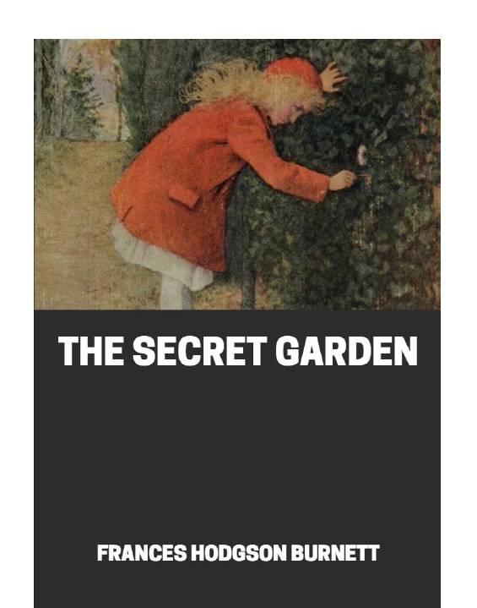
The Secret Garden
This week, we have been reading chapter 4 all about Martha.
Today, you will finish reading this chapter and have 2 longer questions to answer. Remember to use evidence from the text.

Slide 2
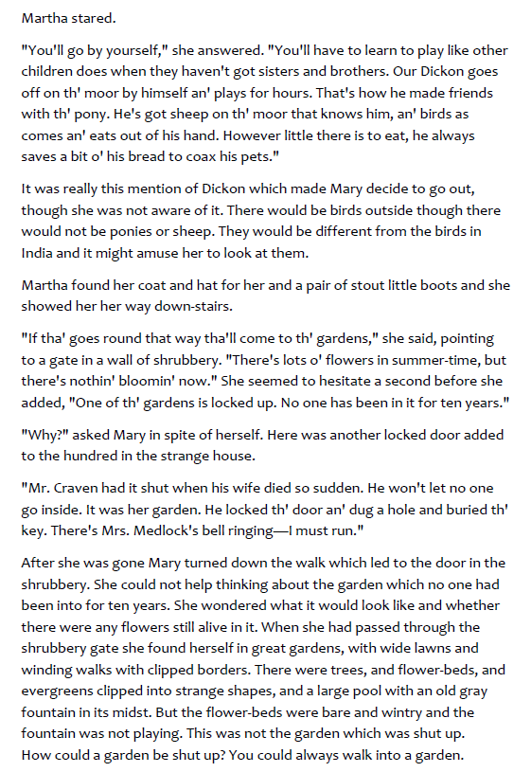
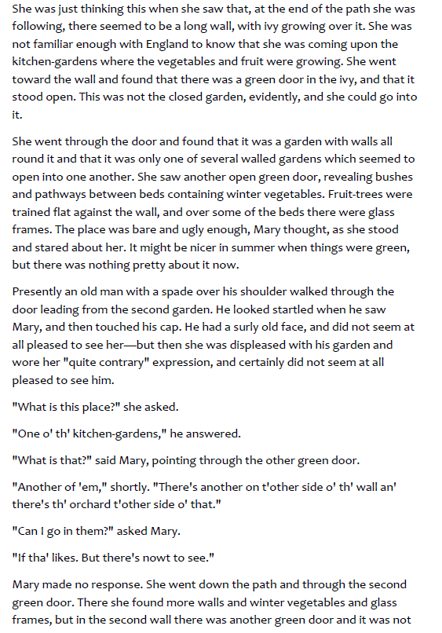

Slide 3
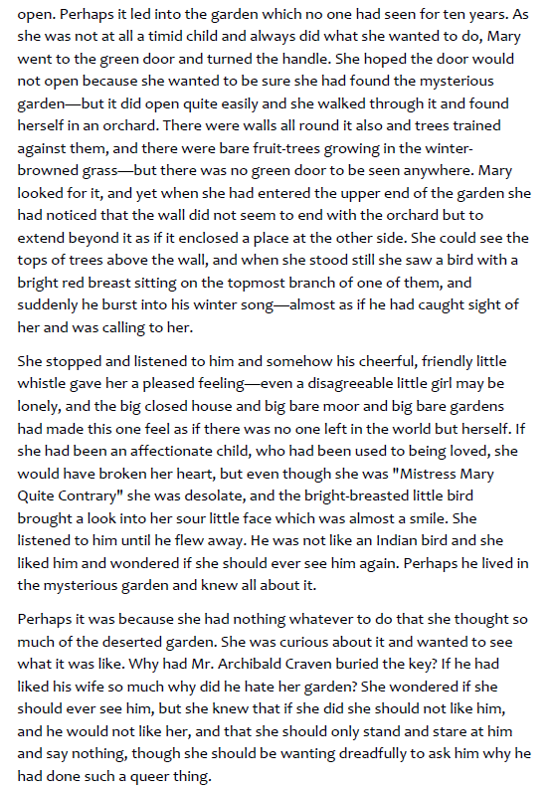
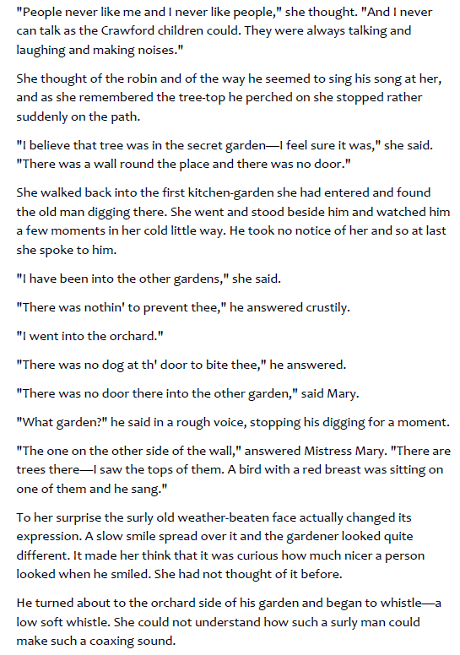

Slide 4
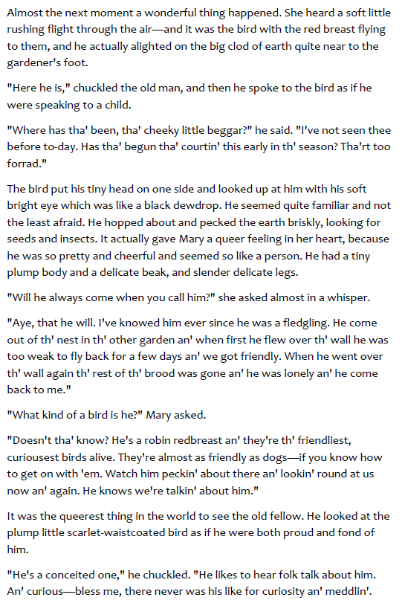
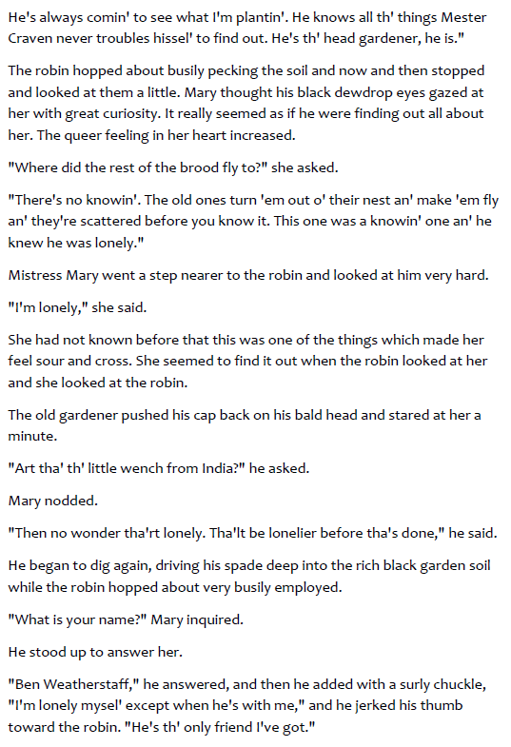

Slide 5
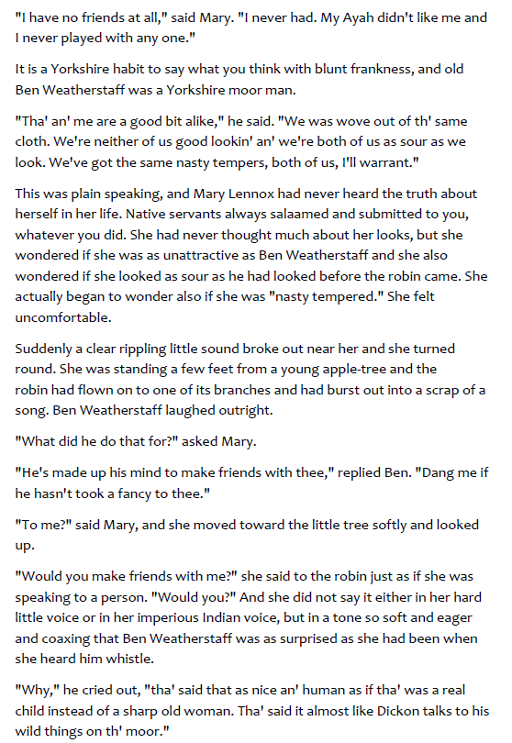
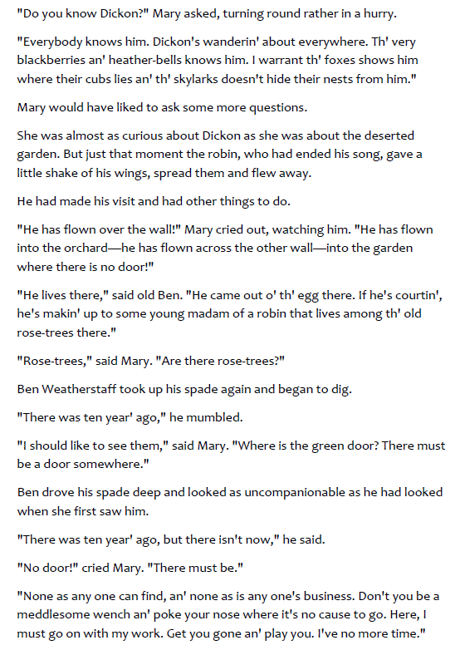

Slide 6

Questions
1) Why is Mary so desperate to find the deserted garden? Explain your answer. (3 marks)
2) What impression do you get of Mary after finishing chapter 4? Think about the choice of words. Use evidence from the text. (5 marks)

