Slide 1
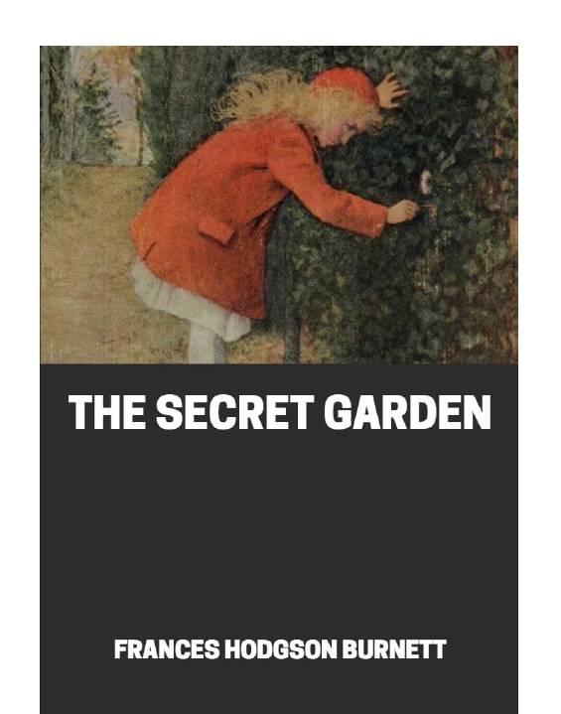
The Secret Garden
Day 4 and 5
You should have read all of chapter 4 and got to the point where Mary has met Martha and is now exploring the gardens outside.
Your writing task for this week is to write a character description for Martha.

Slide 2
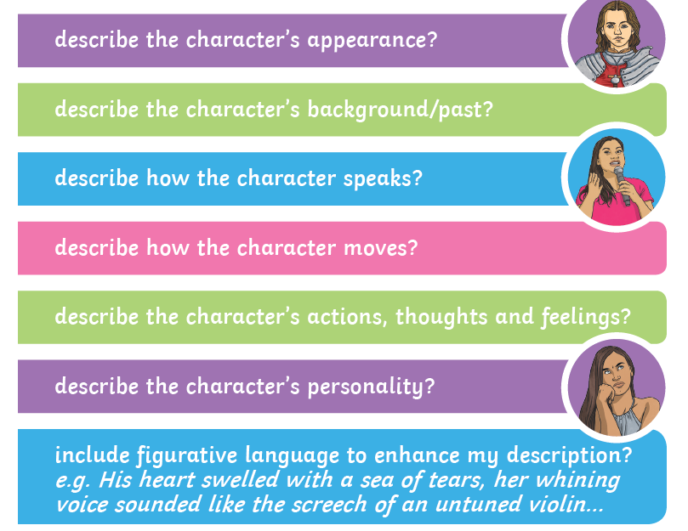
The Secret Garden
Remember to include the following;

Slide 3
The Secret Garden – Edit and redraft
Step 1: Remember the circling of the first word of each sentence edit – you can highlight these on the computer and check that they are capitals and that your sentences are not too long. You also need to make sure they do not all start with the same boring words.
Step 2: When you have checked your sentence starters now highlight all of your nouns – can you expand your nouns into noun phrases? Instead of ‘the girl felt lonely’ you could improve into, ‘the shy, miserable girl felt lonely as no one was caring for her.’.
Step 3: Move onto verbs now. Remember adverbs tell you where, when and how the verb takes place – add some adverbs if you can!
Step 4: Check your punctuation carefully. A Year 6 top set writer should be able to use a wide range of punctuation accurately and you have the benefit of a grammar checker too!
Step 5: If you are hand writing, please take your time to make sure it is well presented.
Step 6: Read your character description out loud to someone who can help you with any final improvements.

