Slide 1

The Secret Garden
This is our third week of studying The Secret Garden.
Last week, we finished reading chapter 3.
Just to recap chapter 3:
Mary Lennox has made the journey to her uncles with Mrs. Medlock.
When they got there, Mr. Pitcher asked for Mary to be taken to her room.
Today, we will be starting chapter 4 and answering the questions.
Please also remember this is an hour's work so take your time to read the text and questions carefully and answer in full sentences.

Slide 2
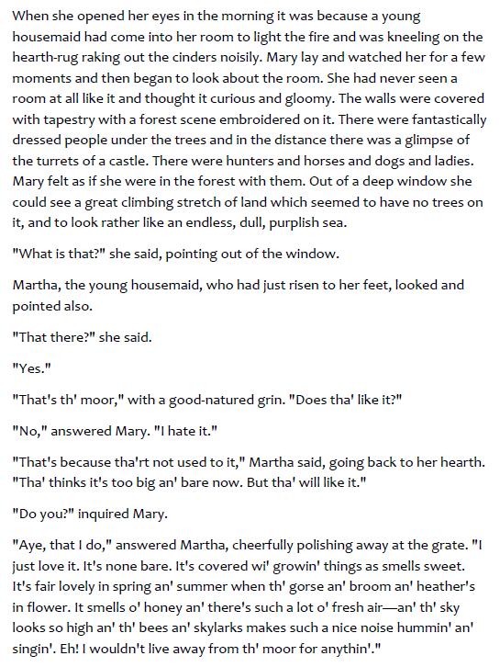
Questions: all on this slide and in chronological
Order
What do you think ‘raking out the cinders’ means?
What did Mary think of the room?
How did Mary feel when she looked around the room?
Who is Martha?

Slide 3
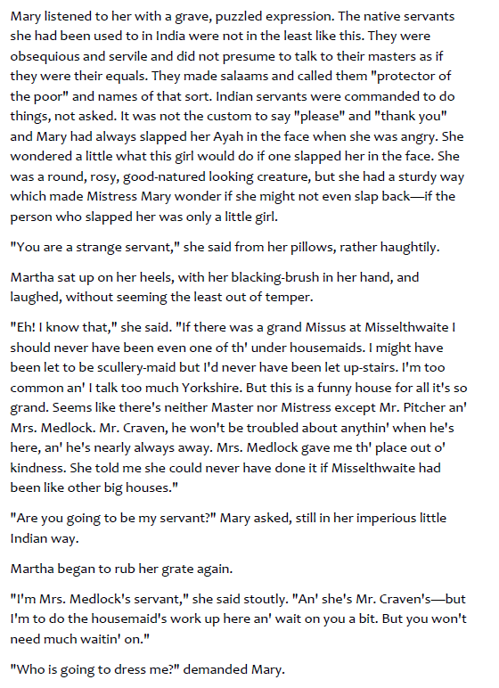
Questions: all on this slide and in chronological order
5) How were servants in India different?
6) What do you think Mary thinks of Martha?
7) What is Martha’s job role?

Slide 4
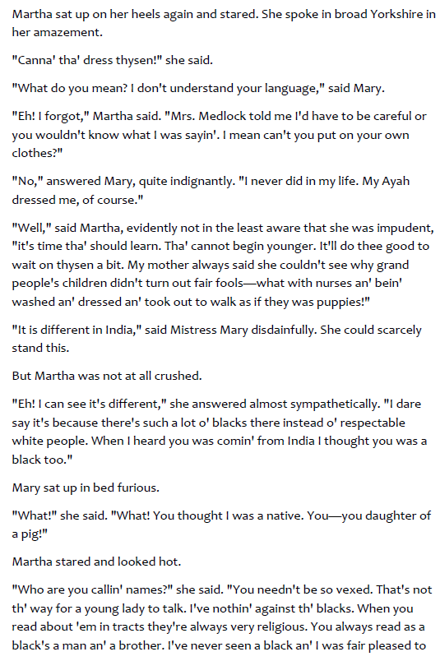
Questions: all on this slide and in chronological order
8) Why is Mary cross when Martha asks her if she can dress herself?
9) ‘She could scarcely stand this.’ What is this implying?
10) Why was Mary furious?

