Slide 1
Teacher notes
Pre-requisite reading:
Flannagan, C., Berry, D, Jarvis, M. & Liddle, R. (2015) AQA Psychology. Cheltenham: Illuminate Publishing. (p.172-173)
https://www.illuminate.digital/aqapsych1/
https://www.simplypsychology.org/experimental-method.html; https://www.simplypsychology.org/validity.html; https://www.simplypsychology.org/reliability.html
Prior Learning:
Lesson 1,2 & 3 covering experimental methods, control of variables & experimental design
WALT, Outcomes & PLC ref.:
WALT: Understand the importance of choosing the most appropriate type of experiment for psychological research. Outcomes: Describe the difference between validity and reliability; Explain different types of experimental research method; Evaluate different types of experimental research method in terms of validity and reliability. PLC ref.: AQA Paper 2 –3.2.3 (a); 3.2.3.1 (m,n)
Starter:
Complete exam questions – feedback on both correct answers & exam technique
Main Activities:
Watch the 2 videos on Reliability & Validity and complete notes in study booklet
Write notes on different types of experimental research method & strengths and limitations
Complete Apply it Concepts activity on P.172, ensuring each choice is justified appropriately
Plenary:
Choose plenary activity
Assessment:
Assessment to be carried out at each activity and appropriate feedback given
Differentiation:
Challenge activities to stretch Higher Ability students; choice of plenary activity

Slide 2
A Level Psychology Year 1 – Paper 1: Psychopathology – Phobias (Clinical Characteristics)
WALT: Understand the clinical characteristics of phobias and how they are diagnosed.
3) Apply knowledge of the characteristics of phobias and their categorisation to scenarios
2) Explain how the DSM-5 categorises phobias
1) Describe the Behavioural, Emotional and Cognitive characteristics of phobias

Slide 3
Describe the Behavioural, Emotional and Cognitive characteristics of phobias
Explain how the DSM-5 categorises phobias
Apply knowledge of the characteristics of phobias and their categorisation to scenarios
Match up activity
Match the phobia to the picture. Be ready to feedback to the rest of the class.
Notes:
Cynophobia = dogs; Claustrophobia = confined spaces; Vehophobia = driving; Apiphobia = Bees; Globophobia = Balloons; Ombrophobia = Rain / rainy days; Kinomortophobia = zombies; Equinophobia = horses

Slide 4
Describe the Behavioural, Emotional and Cognitive characteristics of phobias
Explain how the DSM-5 categorises phobias
Apply knowledge of the characteristics of phobias and their categorisation to scenarios
Activity 1: Think, pair, share..
Individually, jot down any ideas what you think a phobia is
In pairs, discuss and add any additional ideas to your notes
Be ready to share your ideas with the rest of the class.
Definition of a phobia
Phobias are a type of anxiety disorder. Phobias are characterized by a marked and persistent fear that is excessive or unreasonable, cued by the presence or anticipation of a specific object or situation (e.g. flying, heights, seeing blood).
Weird phobias:
https://www.youtube.com/watch?v=9IV13gJ811c

Slide 5
Describe the Behavioural, Emotional and Cognitive characteristics of phobias
Explain how the DSM-5 categorises phobias
Apply knowledge of the characteristics of phobias and their categorisation to scenarios
Activity 2: Characteristics of Phobias
Use p.138-139 of the textbook to annotate the diagram showing Behavioural, Emotional and Cognitive Characteristics of Phobias. Your notes should include:
Key elements of each characteristic
Examples for each element
Emotional
Behavioural
Characteristics of phobias
Cognitive

Slide 6
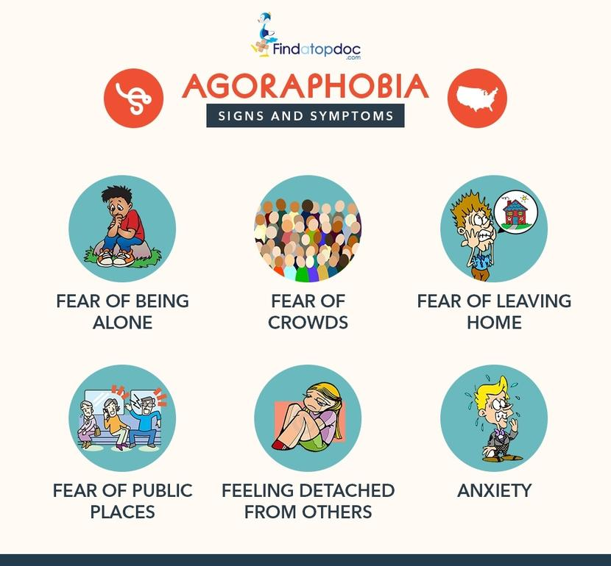
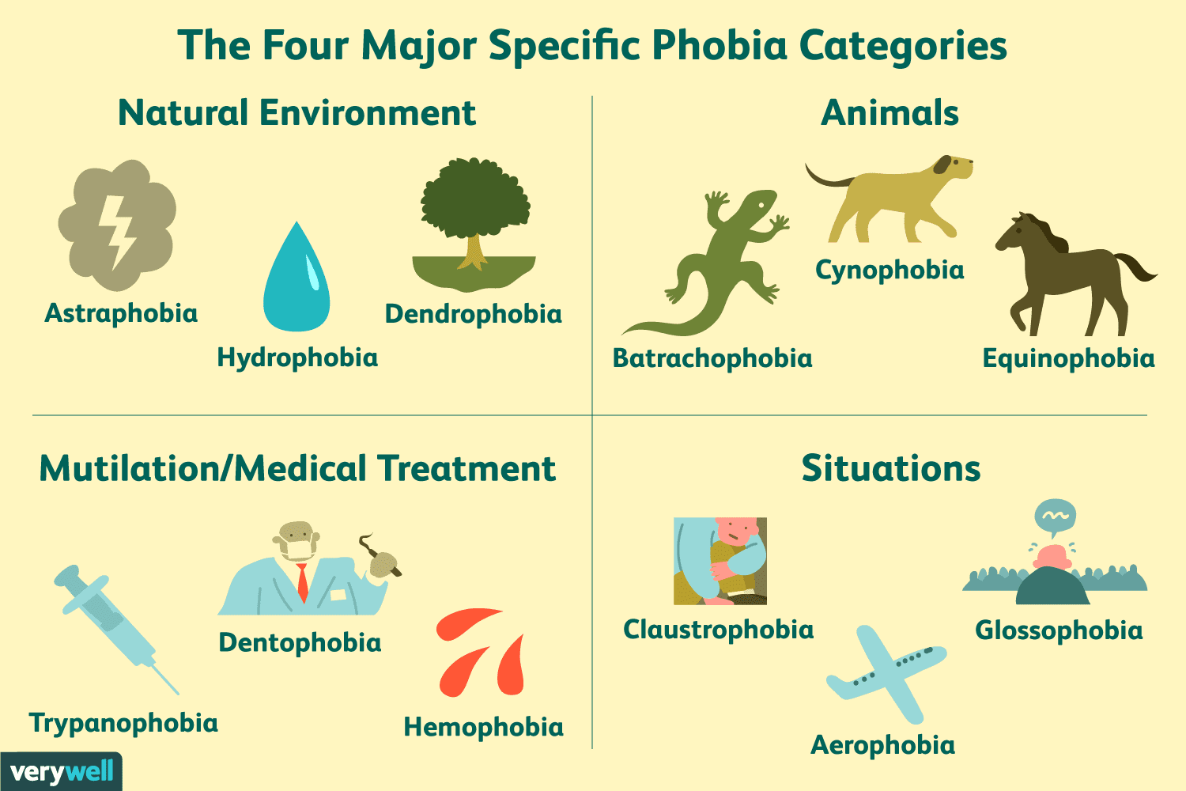
Describe the Behavioural, Emotional and Cognitive characteristics of phobias
Explain how the DSM-5 categorises phobias
Apply knowledge of the characteristics of phobias and their categorisation to scenarios
Activity 3 – Categorising phobias
For the scenarios in your study booklet, identify category of phobia and justify your reasons by picking out key elements in the text

Slide 7
Describe the Behavioural, Emotional and Cognitive characteristics of phobias
Explain how the DSM-5 categorises phobias
Apply knowledge of the characteristics of phobias and their categorisation to scenarios
Activity 4 – Exam Questions
AO1 = 4
The outline might include:
• physiological, behavioural, emotional and cognitive signs / symptoms
• incidence and prevalence
• course and prognosis.
Examiners should be mindful that this part of the question is only worth 5 marks and so candidates are not expected to cover all these points to access the top marks. However, top band answers should refer to some diagnostic criteria – in particular there must be some reference to the underlying anxiety that characterises these anxiety disorders. It is acceptable to refer to different types of phobia but these distinctions on their own are not credit-worthy – they must be accompanied by a description of the characteristics of each type.
AO1 Mark bands
4 marks Outline is accurate and coherent.
3 – 2 marks Outline is limited, generally accurate and reasonably coherent
1 mark Outline is weak and muddled or very limited
0 marks No creditworthy material
Q1. What is meant by a phobia?
(Total 2 marks)
Q1. [AO1 = 2]
Up to 2 marks for a description of features of a phobia.
Likely points:
An extreme fear of an object / situation / activity (1)
An irrational fear (1)
Fear that is disproportionate (to the actual danger) (1)
A fear that leads to avoidance (1)
A fear that is disruptive to everyday life / maladaptive (1)
For two marks there must be some reference to fear.
Q2. Outline characteristics of either phobic disorders or obsessive compulsive disorder.
(Total 4 marks)

Slide 8
A Level Psychology Year 1 – Paper 1: Psychopathology – Phobias (Clinical Characteristics)
WALT: Understand the clinical characteristics of phobias and how they are diagnosed.
3) Apply knowledge of the characteristics of phobias and their categorisation to scenarios
2) Explain how the DSM-5 categorises phobias
1) Describe the Behavioural, Emotional and Cognitive characteristics of phobias

