Slide 1
Fresh start
Home learning Programme
Every day repeat the sound chart several times at least 5
Always do it out loud.
Use links 1 & 3 to help. ( They are on slide 2)
Work through one slide each day
Always starting with sound chart.
The final slide is a full lesson so will take several days.
If you complete still do daily sounds but take one sound each day and list 5 words that include the sound.
If you do above your list will be 220 words which we will share when we return.
Try reading as in ERIC for 15 minutes daily if possible.
Finally keep safe, be happy and email me bernie.walding@tda.education if you have any problems or want spelling test or more work.

Slide 2
Fresh start
Useful links
https://www.youtube.com/watch?v=sjlPILhk7bQ
This link explains the programme for parents. Shows how sound chart works !
https://www.jollylearning.co.uk/register/ Great for going through sounds . Clear and interactive
10 Facts About Slave Ship Conditions - YouTube Fresh start programme lesson.

Slide 3
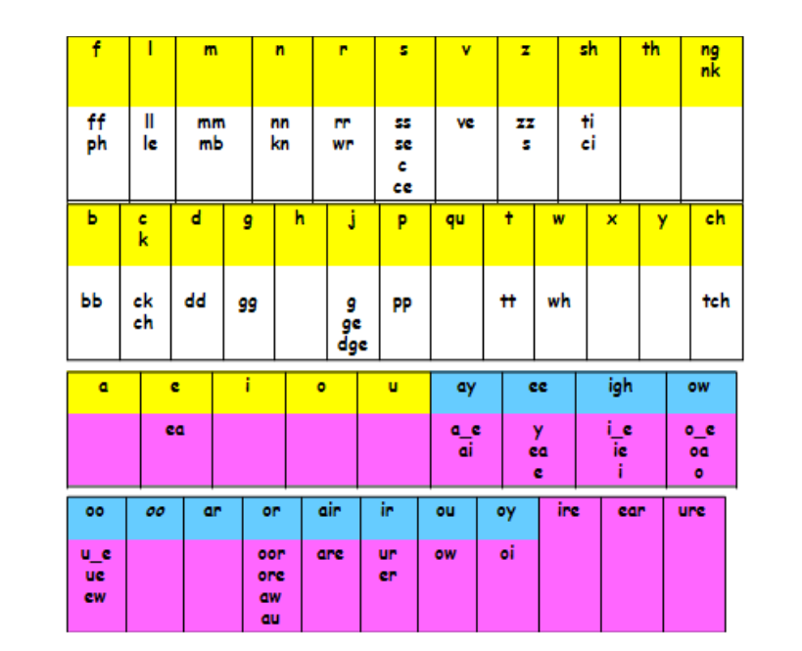
Every day

Slide 4
Phonics chart sounds . Repeat two five minute sessions. Every day
https://www.jollylearning.co.uk/register/
Use this link to hear the sounds

Slide 5
Say the sound
Say the word
Write the word identify sound.
Now use two of these words in a sentence.
play
day
may
way
say
spray

Slide 6
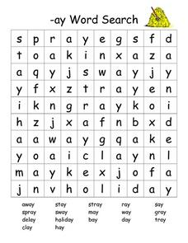
How many can you find?

Slide 7
Now list 5 more words for each sound, use dots . dashes ___
e ea oy I ll ie ur er
Egg sea boy lip full tie fur river

Slide 8
Try these identify the sounds dots /dashes.
May I play?
May I play with the ………?
May I play with the …………. ………………?

Slide 9
Try this remember to use dots / dashes.
I can see the sea.
I can see the sea as I sit on the ……… and ………
Pick another sound from the chart and try to make your own.
Now use a mixture of sounds in your sentence.

Slide 10
Dot. and dash______ all sounds in words below and your own list
List 10 of your ow must be 5 or more letters.
Sunday
Stayed
Haystack
Slayed
Splash
Away
Standing
Hopped
Praying
Cannot
Sobbing
filling
Kitchen
Hurray
Yelled
Offered
Rumpelstiltskin
Tricked
believes

Slide 11
10 Facts About Slave Ship Conditions - YouTube
Fresh start programme lesson.
Go onto this link and work through the lesson.
This lesson will take several 15 minute sessions to complete.

